Slide 1
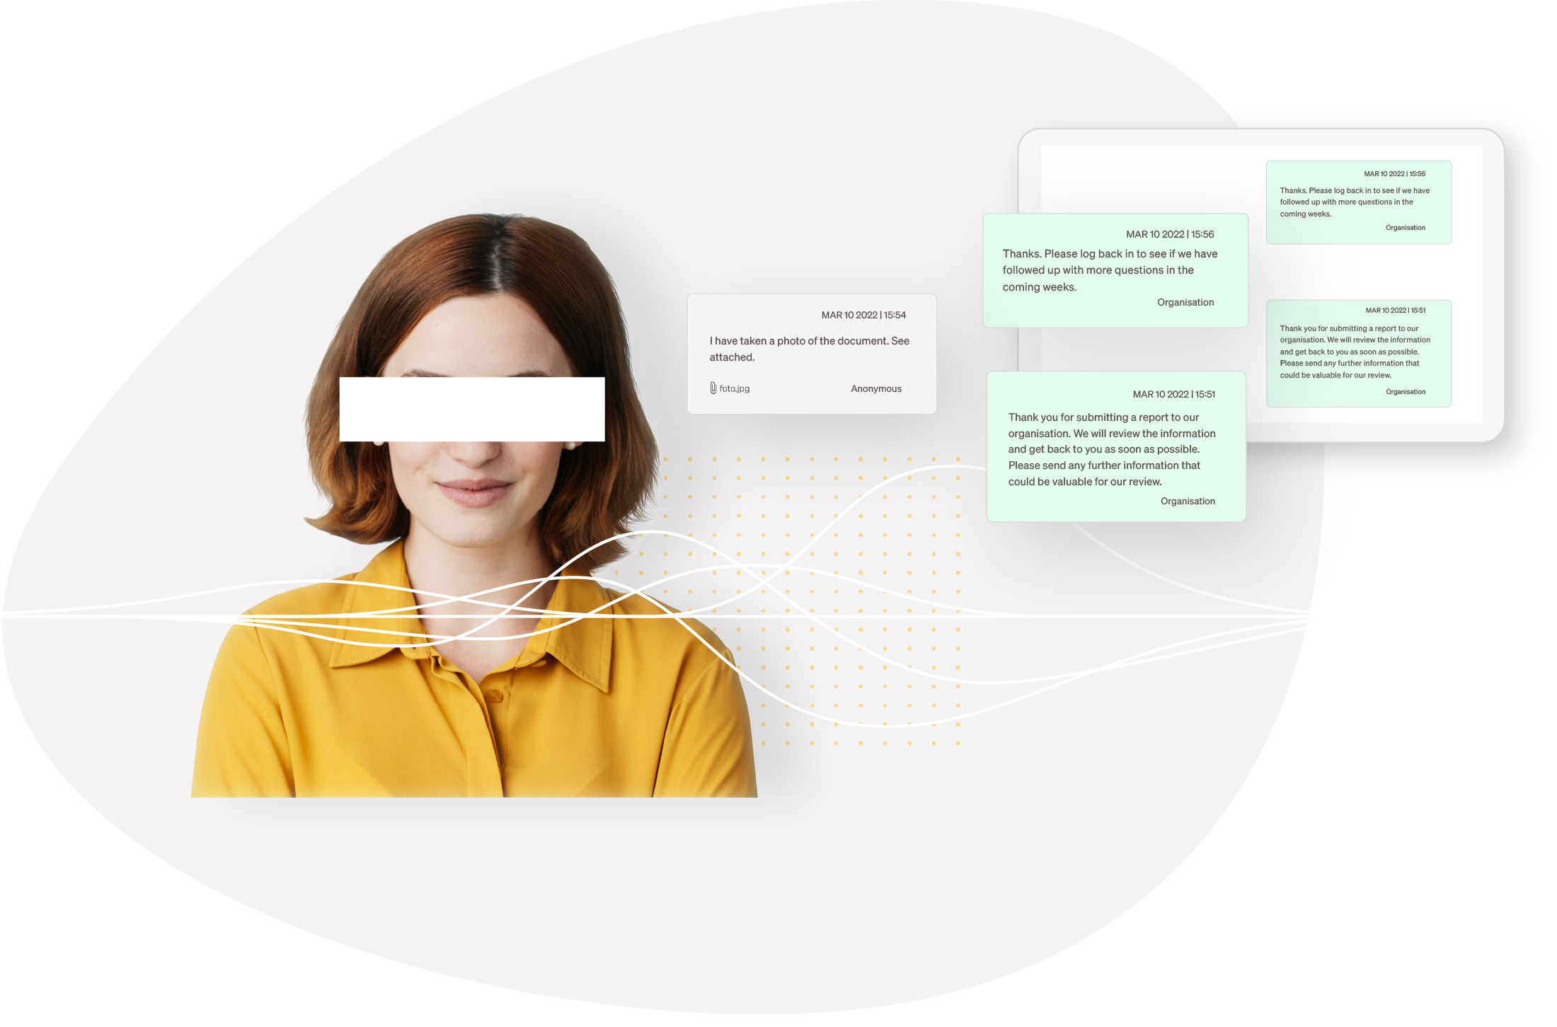

The all-in-one*
Whistleblowing system
* Anonymous reporting channel, case management tool, secure and compliant whistleblower system.

Slide 2

EU DIRECTIVE
EU requires whistleblowing
To meet the requirement of the EU Whistleblower Directive, organisations with 50+ employees and municipalities with over 10,000 inhabitants must implement secure and effective reporting channels.
These channels have to:
Be secure
Guarantee anonymity
Have a designated owner
Adhere to timeframes
Meet GDPR guidelines
Allow written and/or verbal reports

Slide 3


About Whistlelink

Slide 4
OUR MISSION
With a safe and user friendly whistleblower product, we make it easy for any company to be compliant.

Slide 5
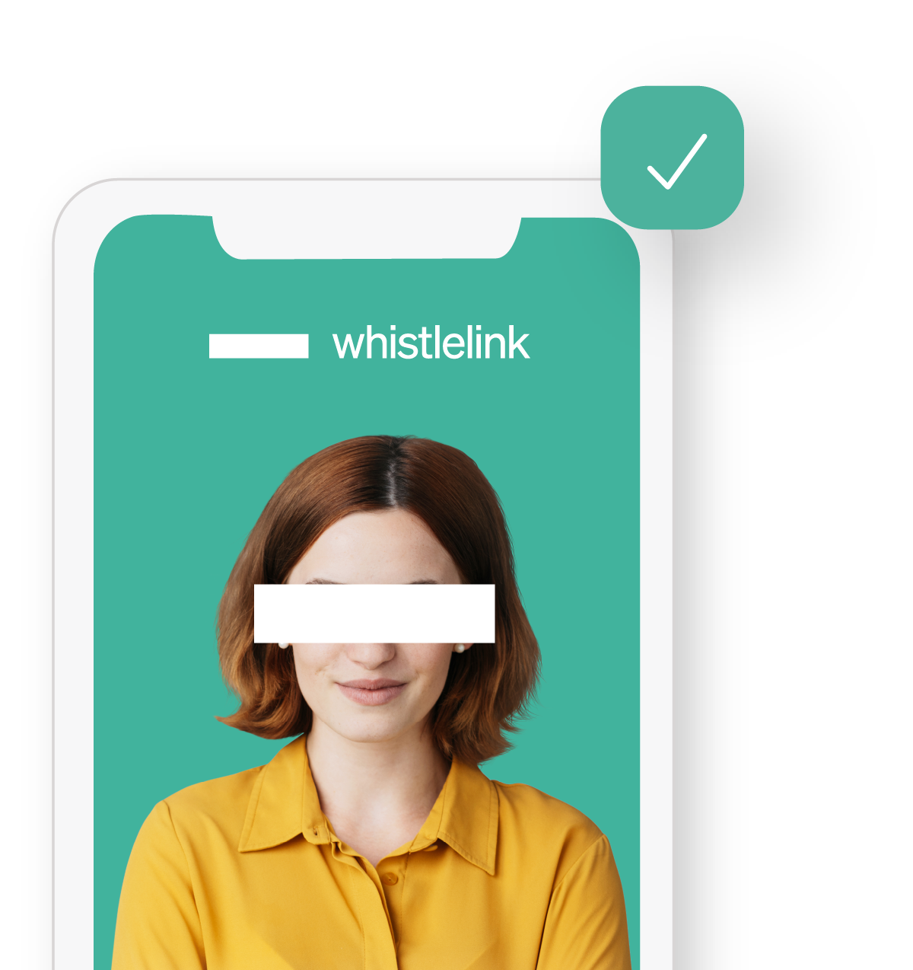
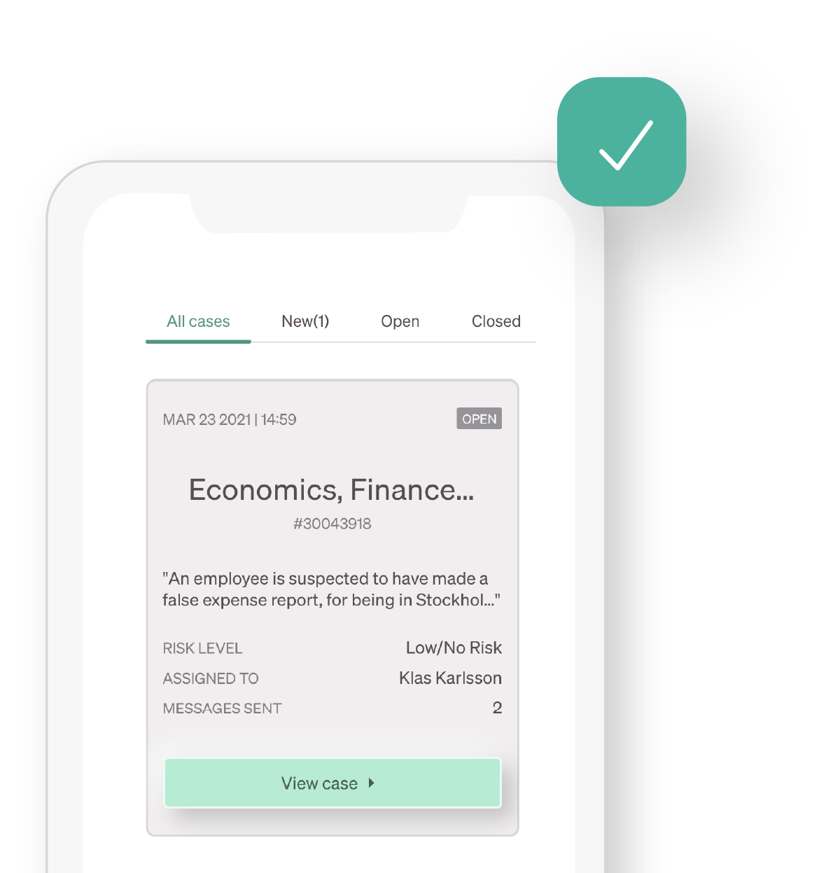
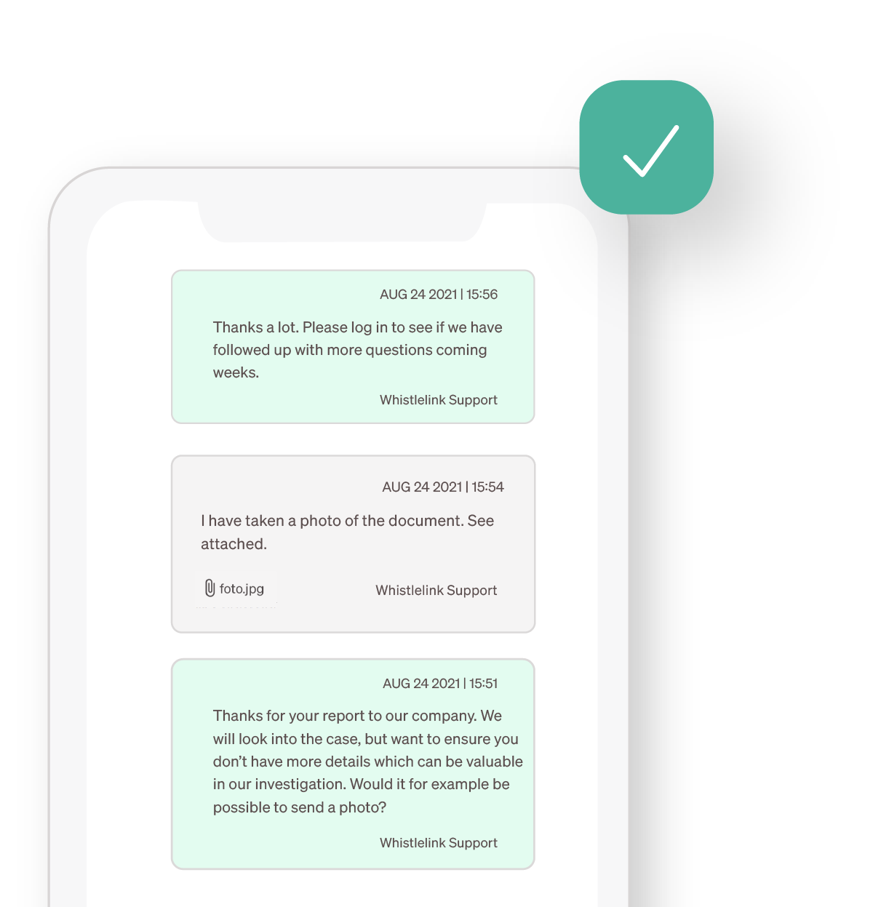
OUR SOLUTION
Easy system to set up, use and manage
Customized reporting site
Safe and secure communication
Case Management module
Be up and running with your whistleblowing site in just 10 minutes. Easily customise text, forms and branding. Pre-translated into 35+ languages.
Powerful two-way anonymous communication between the organisation and the whistleblower. Get alerts when you receive new messages.
Smart and intuitive Case Management with notifications and deadline reminders, risk categorisation, user access controls, documentation and statistics.

Slide 6
OUR SOLUTION
Product in detail
Reminders and alerts
Redaction of sensitive information
Additional reporting channels
Subscribe to reminders and receive alerts for new cases, messages from the whistleblower and when deadlines are approaching.
Protect the identity of the whistleblower by redacting sensitive information and creating anonymised copies of a case.
Add additional reporting channel details, to support reports received from these channels. Manually create and save cases from additional channels in Case Management.
Standard and auto-replies
Report filtering
Case linking
Keep communication consistent and don’t miss important deadlines with standard and auto-reply messages.
Label reports with a risk score and use the function to filter out irrelevant or non-risk reports.
Connect and link cases in your whistleblowing system that relate to the same misconduct or wrongdoing.

Slide 7

OUR SOLUTION
The highest levels of security.
Putting trust in something new isn’t easy. Especially when you need to protect something sensitive. Data security is our top priority. We take multiple measures to keep your information and the whistleblower’s identity safe.
Encryption of case data in transit and at rest
Secure multi-factor verification
Action and data logs
Strict user access control
External penetration testing
Redundancy of data

Slide 8

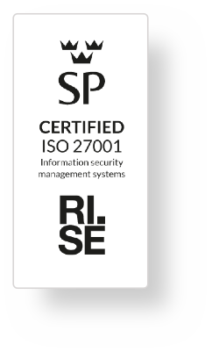
Hosted in the European Union
OUR SOLUTION
As a Swedish owned company, Whistlelink hosts all its servers in the EU. By storing data in the EU, we guarantee compliance with the GDPR and all data relating to the whistleblower stays within the European Economic Area (EEA).
ISO 27001 security standard
GDPR compliant
Whistleblowing Solutions AB, the company behind Whistlelink, shows commitment to data protection and minimising security risks with ISO/IEC 27001 certification. The international standard for an information security management system. This confirms that we handle data security correctly and it is always a part of our product and technical development.
As we only host data on EU-based servers, the data that we store for you is also compliant with the GDPR. So that’s one less thing to think about. Data is also automatically deleted according to the time constraints set out in the GDPR. Full details in our Privacy Notice.

Slide 9
Plans & Services
NEXT STEPS

Slide 10


FLEXIBLE PLANS
Plans for any organisation
POPULAR PLAN
Starter
Flex
Premium
Ready to go
All you need
For larger organisations
Prepared content for your site
One language
Standard visual theme
Standard reporting form
1 user
Standard onboarding
Option to customise content
Up to 3 languages
Custom visual theme
Custom report form
3 users
Standard onboarding
Option to customise content
Up to 10 languages
Custom visual theme
Custom report form
10 users
Standard onboarding
49€
99€
199€
per month
per month
per month
Included in all plans:
Unlimited number of cases, Logo upload, Prepared site content, Communication package, Two-factor login, Statistics, Risk score feature, Help Center.

Slide 11

Intake management
ADD ON SERVICE
FIRST LINE REVIEW OF CASES
Ensure independency in the process
Ensure communication in accordance with the EU Directive and national law
Control whether the case concerns main contact persons
Assign the case to relevant contact persons
Reduce initial workload

Slide 12

Roll Out & Implementation
OUR SOLUTION
Session 1
Knowledge sharing and best practises
Set up and implementation
Review of policies and communication
Session 2
Platform training & Education
Training session of Whistlelink platform: Case Management

Slide 13
About us
WHISTLEBLOWING SOLUTIONS AB

Slide 14
Knowledge & Experience
ABOUT US
Founded in Sweden and have delivered whistleblower solutions for 10 years.
European client base, with clients of all sizes and from all industries, incl public bodies.
Strong focus on IT Security; ISO 27001 certified, GDPR compliant with hosting in Europe.

Slide 15

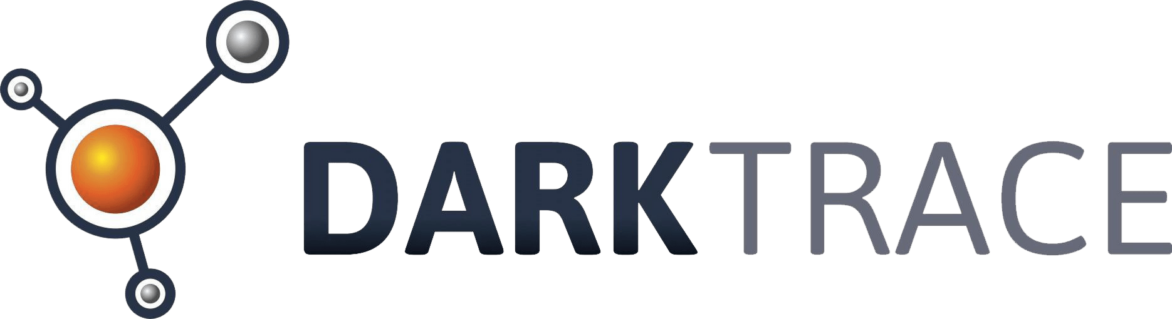






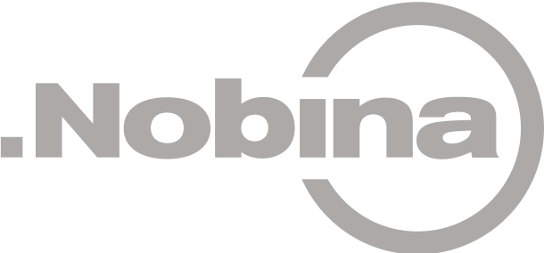






Selection of clients
WHY US

Slide 16
Appendix
OUR USER INTERFACE

Slide 17

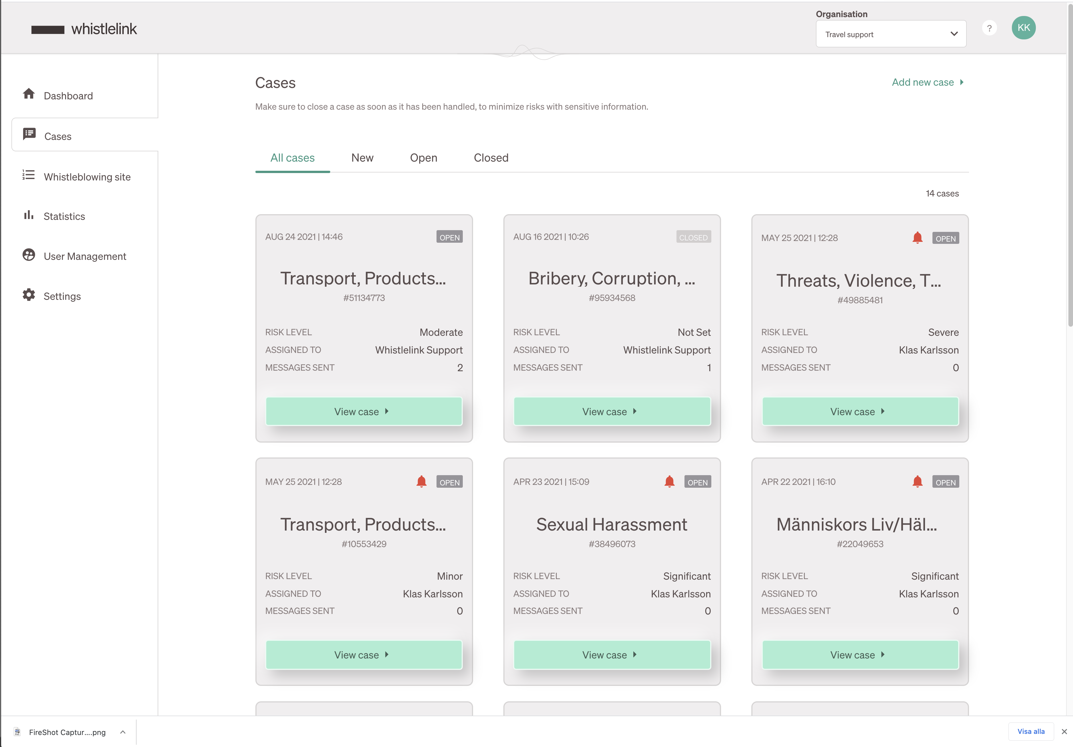
Overview for all cases
OUR USER INTERFACE

Slide 18
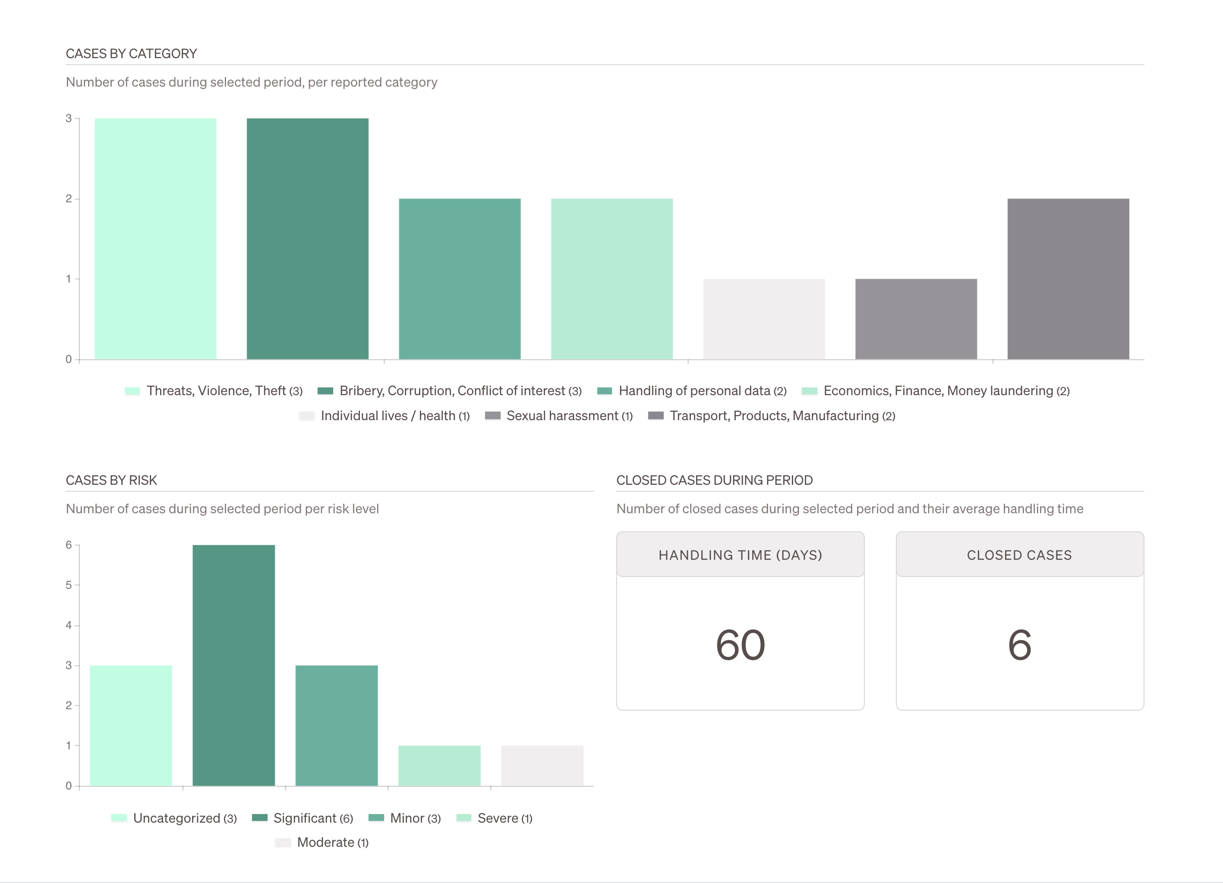
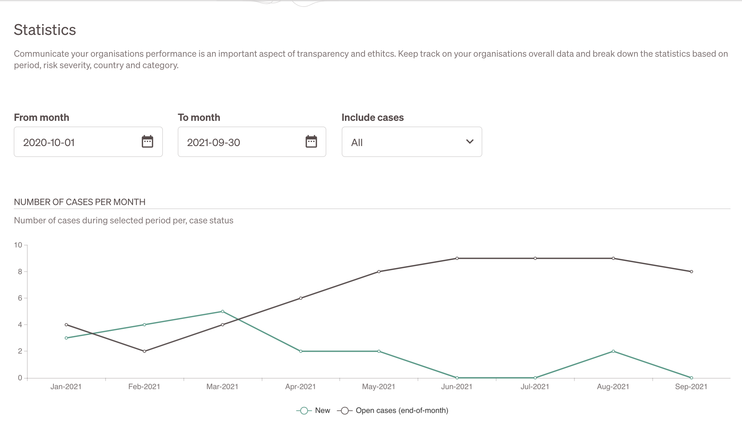
Statistics in infographics
OUR USER INTERFACE
By category and per month

Slide 19
Thank you
WHISTLELINK
Name
name@whistlelink.com
+34 683 530 248

